Slide 1
What Makes for Great Virtual
Reference?
A Madlibs Method of Discovery
Suzanne Bernsten, Lansing Community College
Rachel Minkin, Michigan State University
#acrlmadlibs

Slide 2
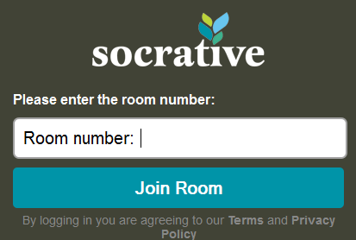
How to Participate
Go to m.socrative.com on a mobile device
Type Room Number 820874
Click on Join Room

Slide 3
Patron
Note: Patron's screen name: George
I'm doing research for my capstone paper and
have been unsuccessful. I don't think I'm using
the correct keywords. I'm trying to find papers
on cancer cluster investigations and the
psychology of why people answer the interview
questions as they do. How they come to the
conclusions they do about an investigation and
how that affects how they answer interview
questions? Do you have any suggestions?

Slide 4
Librarian Response & Best Practice
Hello, George! I'm ***, a librarian at MSU. I am
reading your question and will be with you in a
moment.
Best Practices
Send patron a scripted greeting which includes your name, university, and a brief message letting them know you will be ready to help them soon.
Use the patron's name.

Slide 5
Patron
I was working on a Wilms tumor cluster investigation.
During the investigation, we had to interview the
families affected by the cancer. I noticed that the
interviewees had already made up their minds as to
what caused the cancer and it was evident, to me, that
they would tailor their answers to fit this belief. I want
to write about the psychology behind that. How they
already decided? Why?
the keywords I've used so far haven't turned up
anything - the couple of papers I found weren't really
appropriate for what I wanted to discuss...

Slide 6
Librarian Response & Best Practice
Which databases and keywords have you been
using?
Best Practices
Use closed and/or clarifying questions to refine the search query. Some examples include:
What have you already found?
What type of information do you need?

Slide 7
Patron
I think I will start with what you've provided me.
Fix my outline to include some of this new
information and then, if I need help again, I will
contact the librarian.

Slide 8
Librarian Response & Best Practice
Okay, sounds good. *** is our public health
librarian. http://staff.lib.msu.edu/***/ Thank you
for using our chat reference service. Please
feel free to contact us again if you have more
questions or need additional assistance.
Best Practice
Encourage patrons to return if they have further questions.

Slide 9
Learning Outcomes
Examine a virtual reference transcript in order to review virtual reference best practices (as established by ACRL).
State three virtual reference best practices in order to improve my own virtual reference skills.
Construct a transcript-based training in order to review best practices with librarians at my institution.

