Slide 1
Don't Throw Out the Baby with the Bathwater
Suzanne Bernsten, Web Services Librarian Lansing Community College Library
Notes:
Hello, my name is Suzanne Bernsten from Lansing Community College, where I am the Web Services Librarian. I coordinate the library website, as well as do reference and instruction. I am the liaison to the English Department, eLearning, and the Center for Transitional Learning.
Today I’ll be talking about a strategy for reflective teaching that you can easily implement.
How many times have you tried out a new idea in the classroom and had it not go as planned?
What did you do? Give up on the idea and never try it again? Try it again the same way and get frustrated?

Slide 2
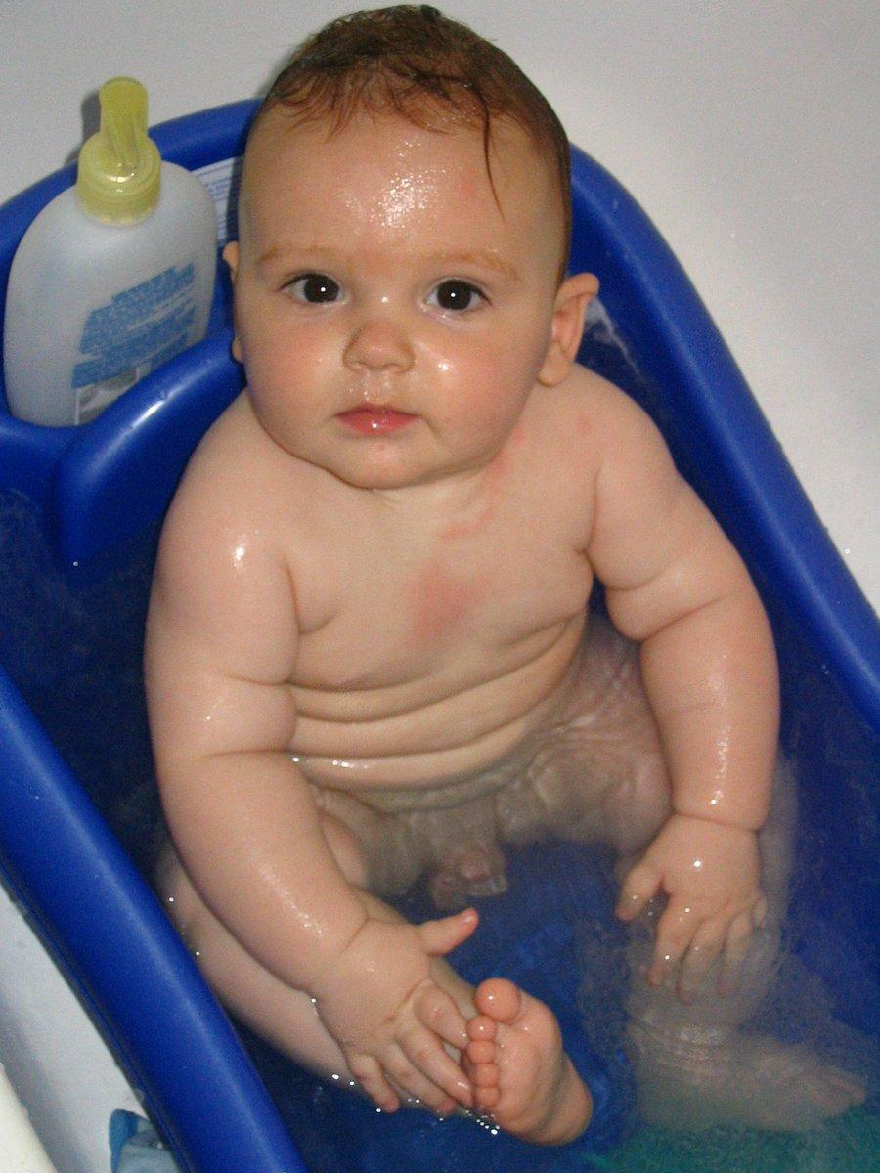
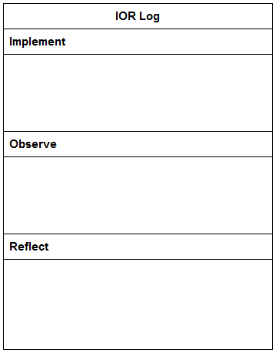
Reflective Teaching: IOR Log
Notes:
Today I am going to talk about keeping an IOR log, a simple tool you can use so you don't throw out the baby with the bathwater! I stands for Implement, O – for Observe, and R for Reflect.
As a participant in a workshop, Transforming Learning through Teaching at the Center for Teaching Excellence at Lansing Community College, I learned about a tool that encourages reflective teaching.
The ideas in this talk are familiar to you because you have most likely engaged in this Implement – Observe – Reflect process informally.
But there is value in formalizing the process by writing down your plan, making observations soon after you teach, and engaging both in self-reflection and getting feedback from peers.

Slide 3
I
M
P
L
E
M
E
N
T
IOR Log
Notes:
Implement
The first step of this process is to write your plan.
What do you want students in learn? Write your learning outcomes.
Then, describe the activity step by step.
Finally, try out the new activity with your students.
You will come back to this section of the log later in the reflection stage.

Slide 4
O
B
S
E
R
V
E
IOR Log
Notes:
Observe
Immediately after you try out the activity, make some observations.
Describe what happened. Don’t try to figure out why things worked or didn’t work at this point, remain descriptive.
How did students react? Were they actively engaged? Did they look like the students in this photo?
How did you feel doing the new activity? Did each part of the lesson flow? Were the transitions smooth?
Again, don’t wait too long to make your observations, capture your thoughts immediately after you teach.

Slide 5
R
E F
L
E
C
T
IOR Log
Notes:
Reflect
Reflection has two parts: self-reflection and peer reflection.
The first step is to look at your observations and make value judgements. What went right? What went wrong? How might you improve it the next time around?
Go back to the Implement and Observe sections of your log and reflect on whether the students acheived the goals that you set for the activity.
Next, share your activity and observations with a peer to get feedback. You can pose specific questions to your peers or leave it open ended.
Finally, take your own reflections and the peer feedback to decide what changes you will make based on what you learned.
This might mean making major changes, making only small changes or scrapping the activity all together.

Slide 6
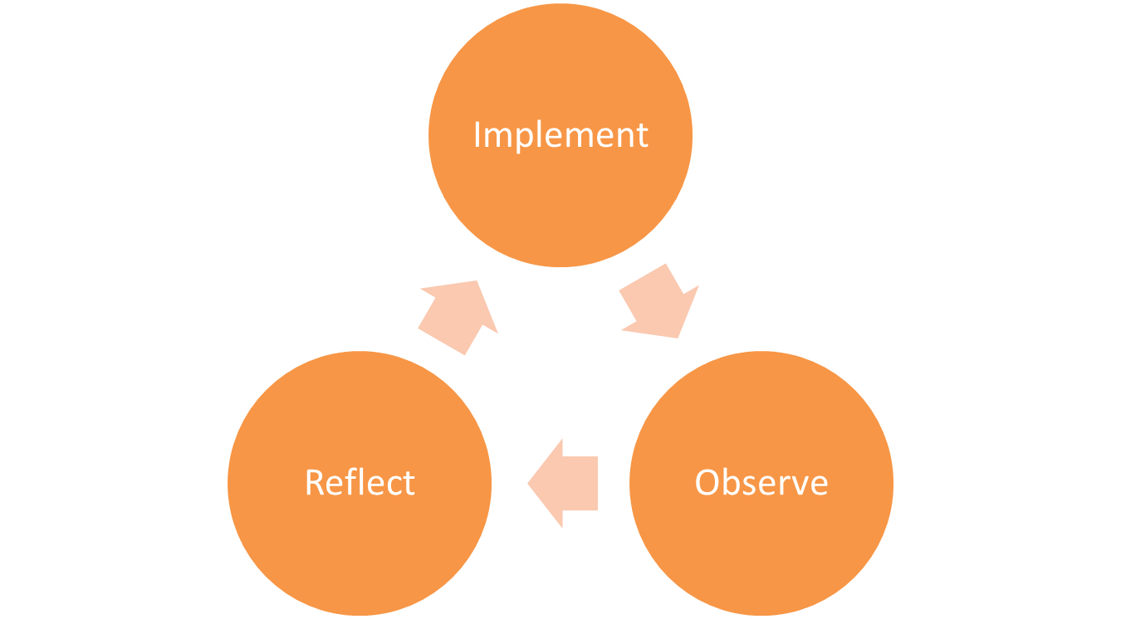
Reflective Teaching: IOR Log
Notes:
As you can see from this diagram, the process is cyclical. You can keep an IOR through multiple iterations of an activity, improving a bit each time.
So, the next time you try out a new activity or lesson, I encourage you to try keeping an IOR log. It will help you avoid giving up on an activity because it doesn’t work the first time. Or repeating an activity the same way when you really could have made improvements with just a little bit of reflection.

Slide 7
Credits
IOR Log
IOR Log Concept
Tracy Price, Director, Center for Teaching Excellence at Lansing Community College
Images from Flickr
Bored Students from Cybrarian77
Reflections from Dead Habits
Find a blank IOR log with questions for reflection you can use or adapt at
http://researchtips.org/ presentations/

