Slide 1

Free (or Cheap) Tools You Can Use to Improve Your Library Website
Suzanne Bernsten
Web Services Librarian
Regina Gong
Manager of Library Technical Services & Systems
Notes:
Introduce ourselves briefly

Slide 2
Don’t forget: You can copy-paste this slide into other presentations, and move or resize the poll.
Notes:
Press F5 or enter presentation mode to view the poll
In an emergency during your presentation, if the poll isn't showing, navigate to this link in your web browser:
http://www.polleverywhere.com/multiple_choice_polls/MTcxNzU1ODA0NA
If you like, you can use this slide as a template for your own voting slides. You might use a slide like this if you feel your audience would benefit from the picture showing a text message on a phone.

Slide 3
Overview
Tools we use
How we use these tools
  Find out how our website is being used
  Add interactivity to our website
Lessons learned
Links to resources
Questions?
Notes:
We want to share tools we have found useful:
to both learn about how our website is being used
add interactivity to our website
We’re not going to describe in detail how to use these tools.
Instead we are going to provide you:
basic information about tools
examples of how we have used them
resources for finding out more
Lessons learned and questions you want to consider before selecting any of these tools
Range of tools today for people with different technical abilities
but most tools involve cutting and pasting code, not doing any coding yourself

Slide 4
find out how your website is BEING used
Google Analytics, Crazy Egg, & Google Custom Search Engine

Slide 5
Find Out How Your Website is Used
GOOGLE ANALYTICS
Notes:
Google Analytics is a web analytics tool that lets you find out statistics about website usage.
It is what you may call a “Getting-to-know-your-users” tool

Slide 6



Popular Free Web Analytics Tools
Notes:
Google Analytics is probably the most popular among the free web analytics tools out there.
It was launched in 2006 and widely used in most library websites
Free; easy to use; flexible; clear reporting mechanisms
While it is free, it is still based on proprietary technology.
Piwik - Open source alternative to GA
downloadable, open source, real time web analytics software program
Open Web – open source web analytics tool

Slide 7
Getting Started with Google Analytics
Set up basic Google account
Sign up for Google Analytics
You will get a Google Analytics Tracking Code
Notes:
Use your library’s name as your account name to separate it from your personal account
Sign up for Google Analytics → free version is called “standalone version”
AdWords service is a fee-based add-on to GA
Free version limited to 5 million page views per month or about 3,000 visits per day
The GATC is the key to making the GA work
You have to copy and paste this code in the pages you want to track. In our case, the code is in the footer in our library website and in our “botlogo” for our catalog.

Slide 8

Page Views
Popular pages
Time on page
Bounce rates
Visitor information
Unique & returning visits
Notes:
Tracks information on your website such as:
Page views or how many times a particular page is viewed → you can watch the numbers to determine trends over time, seasonal spikes or dips or compare w/ other pages in your website
Popular pages or the pages most heavily accessed
Time on page → how long do visitors spend in your website
Visitor information --> how do visitors get to your site; user demographics such as location, browser used, operating system used, etc.
Unique and returning visits
Bounce rates or how many visitors left your site after visiting only one page.

Slide 9
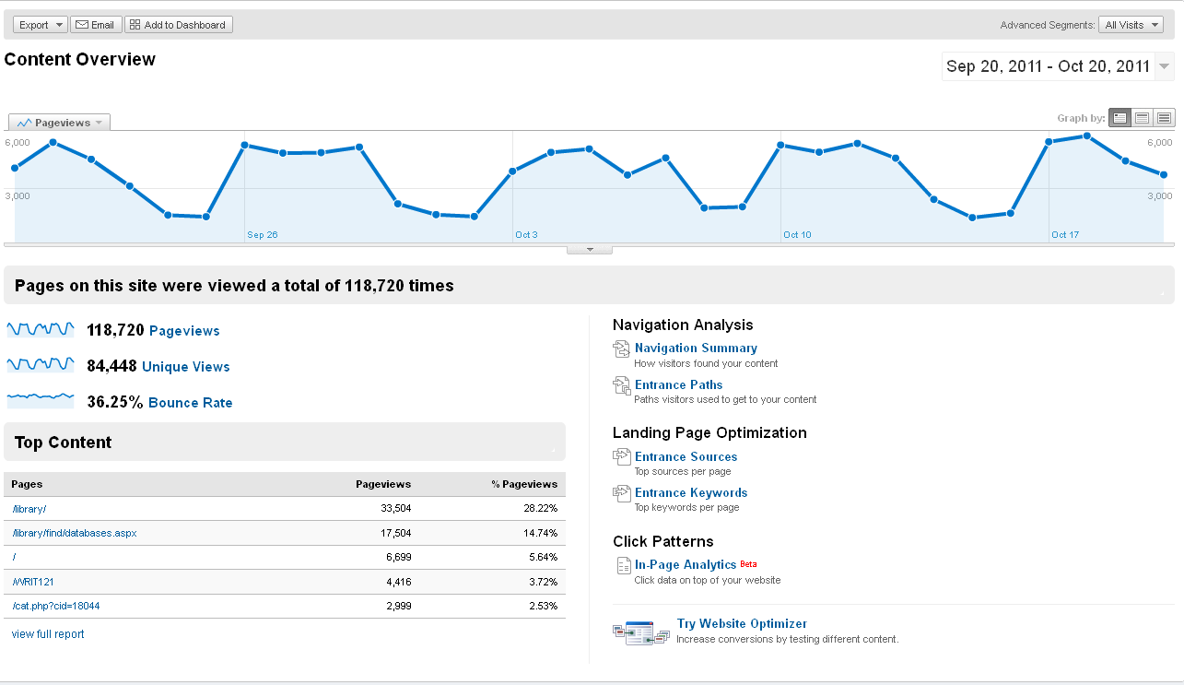
Notes:
This is our Library GA account
Show them a view parts of the report
This is the CONTENT overview page. As you can see we have 118,720 page views
Our most popular pages are the library landing page (of course) and our research databases page followed by our LibGuides

Slide 10
How Do We Use It?
Keep track of popular pages in our website
How people get to our website
Shows results of our marketing
Enabled us to create a mobile version of our Library website and catalog
Notes:
Allows us to see what pages are the most popular/heavily accessed
For example, how many visitors get to our site through the LCC homepage, library catalog, Firescience page, Libguides
Shows results of our marketing we can see how many views are from our Facebook page or from our blog
We saw that people were accessing our library website and catalog through mobile devices so we created a mobile version of them.

Slide 11
Find Out How Your Website is Used
CLICK ANALYTICS
Notes:
While GA was very useful for us, we needed something else to make our analysis a lot easier.
We specifically want to know where exactly our users are clicking in our website and catalog (something that GA can’t provide)
So we turn to CLICK ANALYTICS → Subset of web analytics that reveals where users click on a webpage.
Generates visual representation of what and where visitors are clicking on a particular webpage by overlaying the click data on top of the webpage being tracked.

Slide 12



Free Click Analytics Tools
Notes:
Formerly called “Site Overlay”
accessible from within Google Analytics report
Lets you see how your users interact with your website through click data at the link level
For each link, you can see the percentage of total clicks that occurred on that link
ClickHeat → Visually displays the amount of clicks on a webpage using color ; open-source software, released under GPL licence, and free of charge.
OneStatFree → not many libraries use it but it’s free

Slide 13



Commercial Click Analytics Tools
Notes:
Here are some commercial click analytics tools:
We opted to use CrazyEgg because it combined the capabilities of an in-page analytics and clickheat in one tool.
Also, it’s easier to install and configure than other click analytics tool.
The cost of the plan depends on how many visits or “snapshots” you want to monitor.
It ranges from: $9/month to $99/month depending on how many pages and clicks you want tracked in your website
We chose the standard plan - $19/month (25,000 visits/ month; tracks 20 pages at once).
You can always add pages in your website that you want to be tracked
One caveat: once a snapshot reaches it’s limit, it will stop tracking clicks but it will archive it in the CrazyEgg website.
Just insert a javascript code in your footer to get it going (tracking starts immediately once this is done)

Slide 14
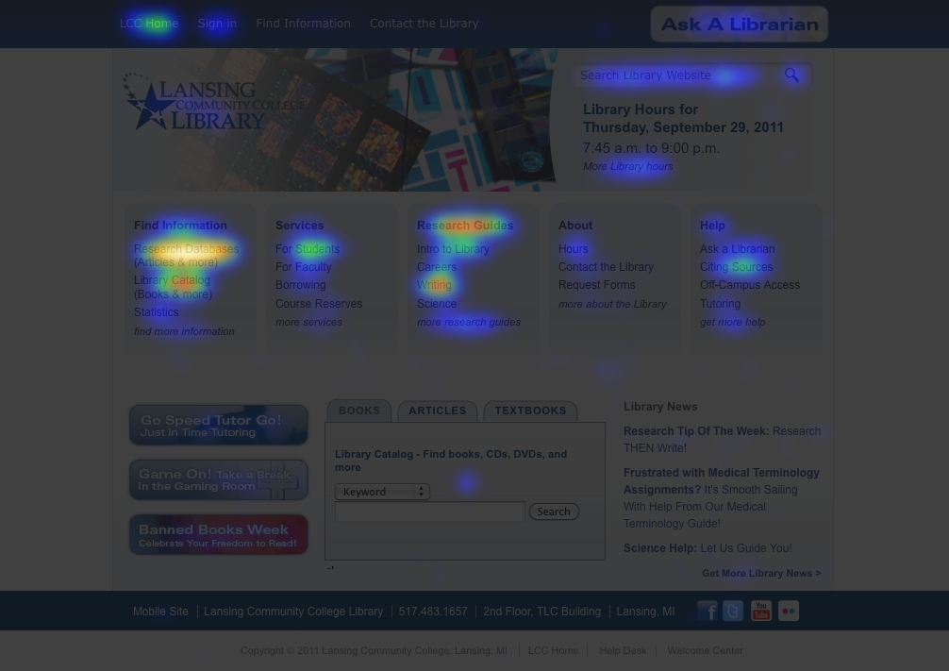
Crazy Egg View - Heatmap
Notes:
Crazy Egg provides you with 3 different views. I will be talking about each of them.
This is the heatmap view from our Crazy Egg account
In this view, we can see where the areas in our website our users mostly clicked on by the intensity of the colors→ The brighter the area, the more popular it is. The darker the area, the less popular it is.

Slide 15
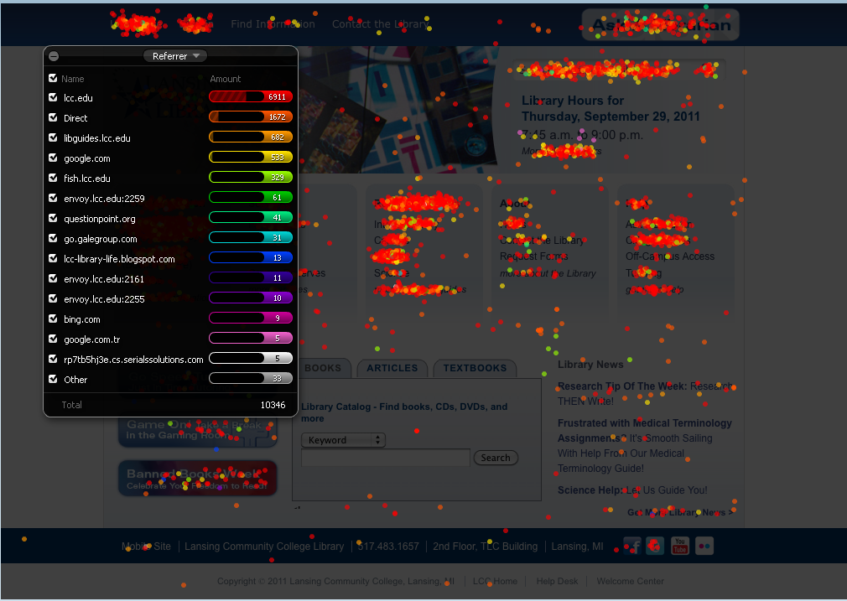
Crazy Egg View – Confetti
Notes:
Confetti view displays every click and overlays those clicks as colored dots → focuses on clicks on the web page level
It also shows referring sites or where your users are coming from → in this case most of our users come from the LCC website

Slide 16
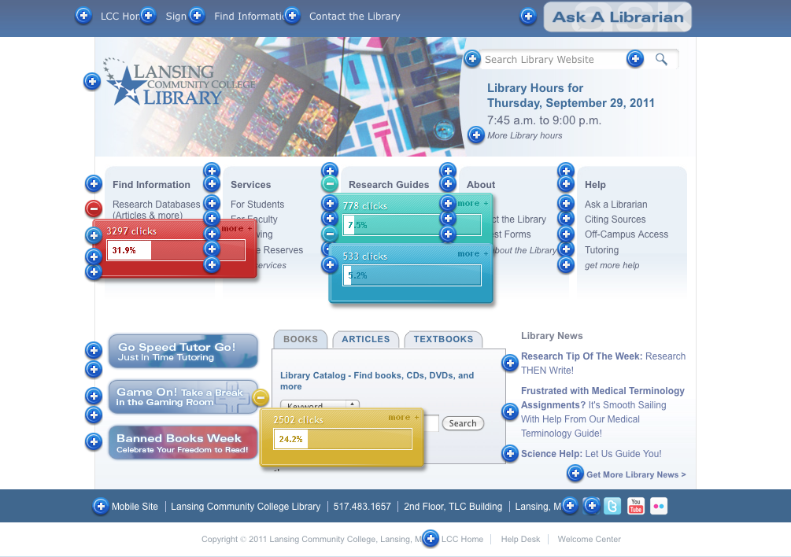
Crazy Egg View – Site Overlay
Notes:
Site overlay displays the number of clicks a link receives including graphics or images in your website
They are color coded to make it easier to see which areas are more popular. For example, a blue button indicates that the area is not as popular as an area marked with a red button.

Slide 17
Changes Made Based on Crazy Egg Data
Website changes
  For Students page – moved link to research guides at top of page
  Ask-A-Librarian page – removed link to Research Help Now
Homepage changes
  Eliminated footer and moved footer links to the header
  Created center column to highlight guides
  Removed tags in LibGuides homepage
Notes:
Website changes:
Because it was the most popular link on the page and it was buried at the bottom of the page
2. And directed patrons to the chat box because they were seeking help from non-LCC librarians when we were available.
Homepage changes:
Footer not used
Research Guides link used a lot
they were not being used

Slide 18
Find Out How Your Website is Used
Google Custom Search Engine
Notes:
Free tool from Google.
Can create a custom search engine for your website and analyze results to understand how patrons are using your website.
Before we had no ability to customize search box – searched college website – now we limit search to the library website
First added this, was excited to be able to give patrons the option to search, but didn’t realize what valuable data it would give us about how patrons use our website.

Slide 19
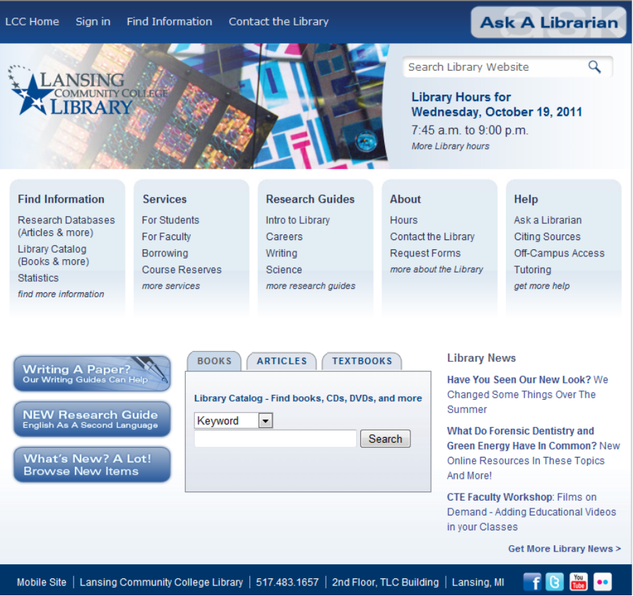
How it Works
Notes:
How it Works
Create a custom search engine for your website.
Or you could create engine with high quality websites on a given topic.
Add all domains you want to include – e.g. website, libguides, blog
Customize look and feel of search box
Cut and paste code into your website
Search box on our library website header – “search library website”
Connect your Google Custom Search engine with Google Analytics to make it easier to analyze results.
Overview of the type of results you can get:
How many people search
What are the top searches
For specific search term – where did users start, how long did they stay on your site after, how many leave after searching without finding what they need?
Start Pages - Which pages do most patrons search from? Why?
Amount of Data can be overwhelming – here are a few ideas for using the data

Slide 20
Identify Content That…
Exists but is Hard to Find
On Your Website
  LINKS Tutorial
  Syllabus
  Films on Demand
On a Specific Page
  APA Citation
    Citation inside a paragraph
  Find Multimedia
    Artstor
Needs to Be Created
Citation examples
  Cite a table
  Cite a play
  AMA citation
Existing Services
  FAX machine
New Services?
  check out nook
Notes:
Exists but is hard to find
After redesign:
LINKS tutorial
Syllabus – used to be on homepage
We added links to these pages in more places and the number of searches for these terms went down.
Needs to be created

Slide 21
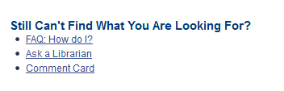
Confusion over
“Search Library Website”
People use it to search for
  specific book titles
  ISBNs
  general topics, e.g. capital punishment
Change message on search results page?
Notes:
Overall Problems with Search
Misunderstanding site search – people see a search box and want to use it – people try to use it to find books, find articles, isbn numbers, course reserves
Currently on Search Results page (Now – links to FAQ, Ask a Librarian, Comment Card) “Still Can’t Find What You Are Looking For?”
Instead → If you are looking for articles, try… If you are looking for books, try…

Slide 22
Tools to Add Interactivity
Blogger, Widgetbox, Google Docs & Dapper
Notes:
surveys, interactive whiteboards, rss feeds of catalog searches, promotion of new materials

Slide 23
Add Interactivity to Your Website
BLOGS
Notes:
Blogger is a free blogging tool now owned by Google. Very easy to use and has a clean look to it.
Started using our own library blog during our website redesign in May 2010

Slide 24
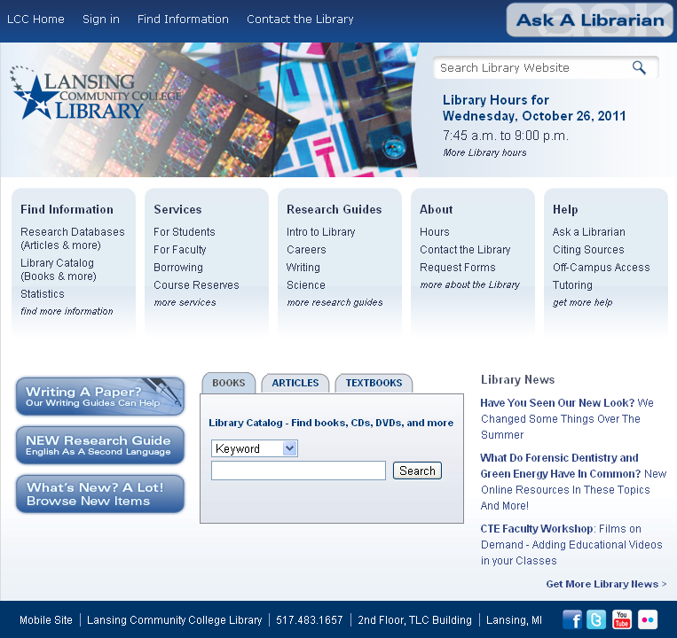
Notes:
This is the Library homepage→ point the left and right side
The information you see on both sides are fed off from our blog

Slide 25
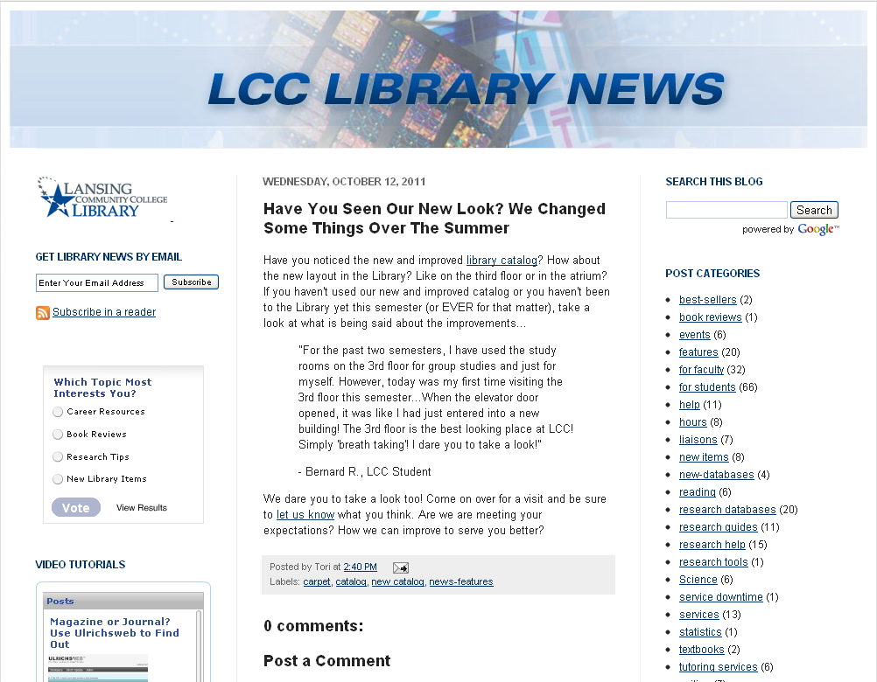
Notes:
This is how our blog looks like:
It takes you here when you click the links from our library website
It is arranged chronologically with the latest on top.
Users can search the blog or search by categories.
Users can also post a comment if they want.
We also made it possible for users to subscribe to the blog by entering their email address
This way, they automatically get notifications whenever a new blog post is added

Slide 26
How Do We Use Our Blog?
Promote or market library services
Highlight new resources
Inform patrons on what’s happening
Communication tool for librarians in their liaison areas
Professional development
Notes:
3. Sometimes we put in a poll in our blog and ask our patrons what they think of let’s say, what topic most interests you? (TAKE THEM TO THE PREVIOUS SLIDE AND SHOW POLL)
4. For example, we advertise Café Scientifique and then we write a blog that have links to the topic of the month.
5. We have another blog called “The Next Chapter”. It’s an internal blog where we post links to interesting things we’ve read, websites we found, to report on conferences or workshops we’ve attended.

Slide 27
Management
Every staff has access to Blogger
One staff reviews blog posts and edits them when needed
Schedule is set up for publication of blog posts
Notes:
They can write blogs on topics that they know about such as things they’ve read, promotion of new library items. New databases, MeLCat, new libguides, tutoring help, etc.
Once it’s written, we save them (we don’t publish yet)
Then our Communications and Marketing staff reviews it to make sure the links are working fine or does some corrections to the article.
This way we have a regular queue of blog entries waiting in the wings to be published.
Issues:
Not all staff are comfortable writing for the blog. We are going to have a workshop on “Writing for the blog” so people would be more comfortable writing posts.
We have also opened our blog to students, faculty and staff to contribute articles so we can post them in our blog as well.

Slide 28
Widgets Galore!
WIDGETBOX
Notes:
Widgetbox - http://www.widgetbox.com/
What is it? - Create customized web widgets that let you share website content.
Cost - $30/year for 10 credits to create unlimited basic widgets, 10 pro widgets
- remove “get widget button”

Slide 29
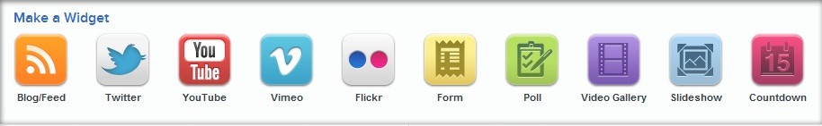


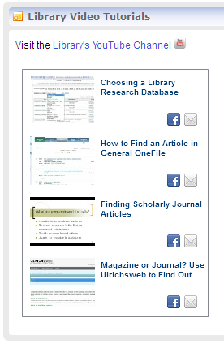
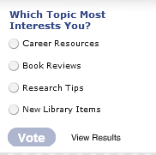
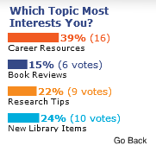
Types of Widgets
on Find Articles page & in Research Guides
on Library blog
Notes:
How it Works
Select the type of widget you would like to create. Templates for different types of widgets.
Enter information about the widget.
Cut and paste code into your website.
Widgets can be shared with users (get widget button).
Paid accounts allow for removal of button and allows you to collect and view statistics on widget use.
Examples
Poll – installed in blog – http://lcc-library-life.blogspot.com/
YouTube – Video Gallery installed on Find Articles page - http://www.lcc.edu/library/find/articles.aspx and in Research Guides

Slide 30

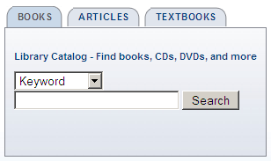

Widget Sharing
on Homepage, course management system, and library search tools page
Notes:
Remote Widget – installed on Homepage, CMS, and library search tools page
Can share on Facebook, webpage, iGoogle, etc.
Give more examples of Widgetbox widgets later when I talk about Dapper

Slide 31
Collaboration & Feedback
GOOGLE DOCS

Slide 32
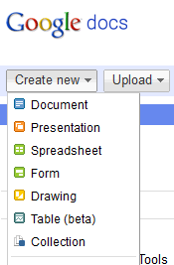
Notes:
How it Works
Create files online
Edit and access from anywhere
Upload existing Microsoft Office documents; download in Microsoft Office formats
More than one person can edit a document at a time.

Slide 33
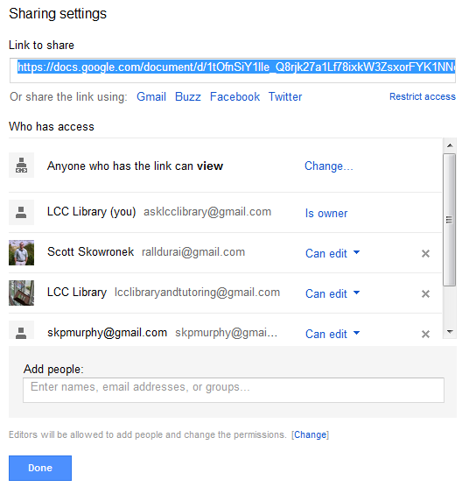
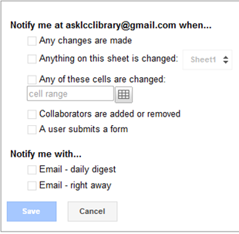
Unique Features
Sharing
Notifications
Notes:
Many levels of sharing
Can give others access to view or edit
Most private – see but not edit
Most public – anyone can edit, everyone can see
Notifications
Useful for feedback forms – comes to your email, but data is stored in the spreadsheet

Slide 34
Google Docs in Action
Collaboration Tool
Online Whiteboard
Library Instruction
Search Strategies: brainstorm keywords
Meetings & Presentations
Collaborate on document during meeting, e.g. write team goals together
Create handout and presentation with co-author(s)
Feedback Tool
Form → Spreadsheet
Library Instruction
Students: One Minute Paper
Faculty Testimonials
Library Website
Mobile Website
Research Guides
Library Catalog
Notes:
Use documents to create an online whiteboard
Brainstorm keywords activity (show document in context)
Use forms to survey patrons and store results in an online spreadsheet
Get qualitative feedback from students in instruction sessions (show feedback)
Faculty testimonials
Advantages for Collaboration
Notification if changes are made
Different types of permission – to view, to edit
Pitfalls
Someone else can delete the document if you give editing permission, instruction example
Can’t make links open in new window in Docs
formatting presentations not as easy as PPT

Slide 35
DAPPER: THE DATA MAPPER
Notes:
Free tool to add content management system type features to your website.
Create a feed from content on your website or library catalog and distribute it in a variety of ways.
e.g. scrape content such as a library staff list for use on your website and a library intranet
e.g. create an RSS feed from catalog searches or featured lists and embed the feed on your website with tools like Feed2JS or Widgetbox

Slide 36
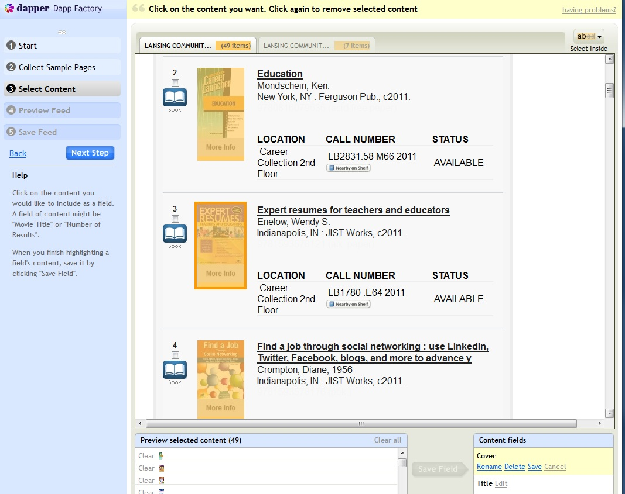
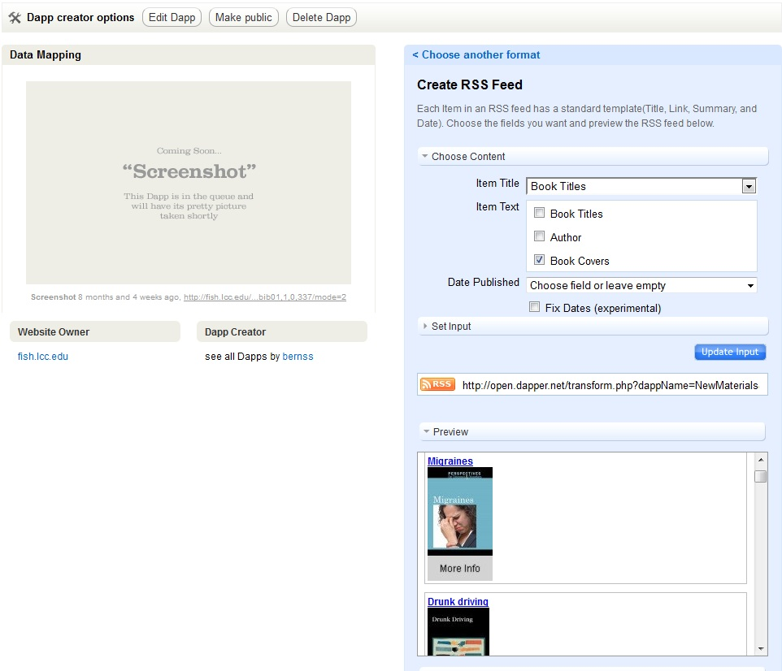
How it Works
Notes:
Choose sample pages from your website/catalog to analyze.
Select the parts of the pages you want to use and give each part a label.
Decide what type output you would like: RSS feed, HTML, Google Gadget...
Figure out how to integrate code into your website, depends on the type you choose.

Slide 37
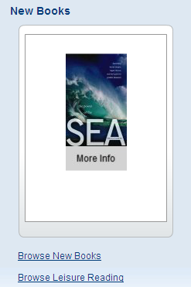
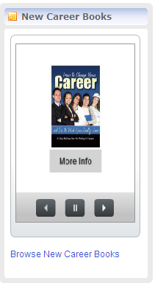
Dapper Examples
(Dapper RSS feeds in Widgetbox Widgets)
On Find Books page
On Career Guide page
Notes:
New Books
Used Dapper to create an RSS feed of Featured List in the Catalog – selecting covers and titles
Created a Widgetbox Widget with the RSS feed
Randomly displays new books
Hover over book, see the title, click on the title, go to the catalog record – can even send link to facebook, twitter, etc.
New Career Books
Used Dapper to create an RSS feed of catalog search of books in the career collection, arranged in chronological order
Created a Widgetbox Widget with the RSS feed
Randomly displays new books
Show widget in action on New Books Page
Plans to create more widgets for Research Guides for specific areas – e.g. new history books for history research guide

Slide 38
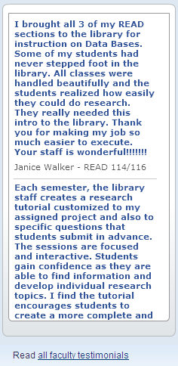
Combining Tools
Faculty Testimonials on Faculty Page
Form
(Google Doc)
Spreadsheet
(Google Doc)
RSS feed
(Dapper)
Widget
(Widgetbox)

Slide 39

Lessons Learned
Set aside time to analyze reports
Start small
Nothing is “free”
Make small changes based on the data in your reports
Need to supplement with usability testing
Notes:
Analysis of the information generated in GA takes a lot of time so you really need to find the time to do that (maybe once or twice a semester?)
Start small → since the amount of information can be overwhelming. Focus on a particular page in your website that you want to monitor to see the trends
While the tools are free, you have to make an investment of your time and effort in learning about how these tools work.
Make sure you actually do something concrete to change your website based on the results you get even if it’s just a small change such as removing links or moving links on top instead of below so your users can find it easily.
You will find that the more you use this tools the more familiar you become and you’ll think of creative things to use them.
Finally, you need to supplement with usability testing.
We found that if there is a search box on a page – Crazy egg - people use the search box, but do they find what they are looking for? Do they understand what they are searching?

Slide 40
Questions?
Find links to tools and examples from
presentation at:
http://delicious.com/stacks/bernss
Please refer to the handouts too.
Notes:
Also please refer to the handouts that we have.
There’s a helpful section there that provides you with questions to consider before you adopt a new tool (read portions of the question)
We can have a poll again after (?)

Slide 41
Don’t forget: You can copy-paste this slide into other presentations, and move or resize the poll.
Notes:
Press F5 or enter presentation mode to view the poll
In an emergency during your presentation, if the poll isn't showing, navigate to this link in your web browser:
http://www.polleverywhere.com/multiple_choice_polls/MTc3MjI5NTgzMQ
If you like, you can use this slide as a template for your own voting slides. You might use a slide like this if you feel your audience would benefit from the picture showing a text message on a phone.

