Slide 1
Information Literacy at LCC
Suzanne Bernsten – Web Services Librarian

Slide 2
Research Questions
What types of assignments do faculty give students which require research?
How effective are assignment handouts in guiding students to successfully complete those assignments?
What type of support do students need to complete research assignments?

Slide 3
Methods
Survey
Interviews
Assignment Handout Analysis

Slide 4
Survey
Notes:
We work a lot with writing and developmental education classes. I chose classes across the curriculum that were either core or MTA classes. After sending out the initial survey, I realized it would have been better to survey programs rather than specific courses. So I sent out a 2nd version of the survey to education, humanities, and business faculty.
Survey – 121 faculty about types of research assignments required in classes
Overall, 49% response rate.

Slide 5
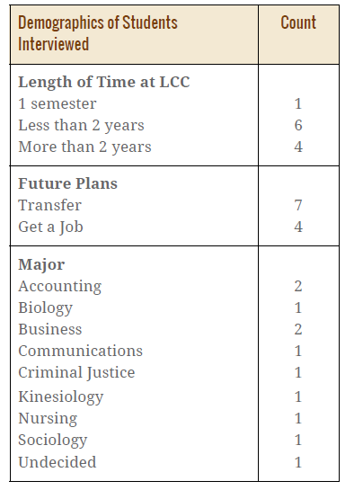
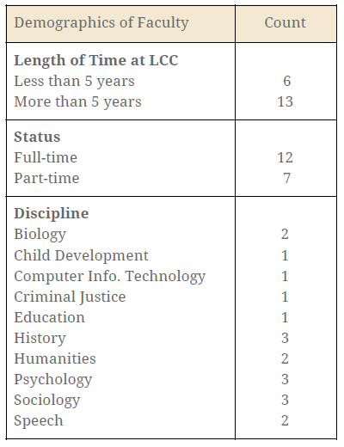
Interviews

Slide 6
Assignment Handouts
Collected 34 research assignment handouts
Analyzed 16 assignment handouts

Slide 7
What types of assignments do faculty give students which require research?

Slide 8
“Other” types of assignments
Traditional research paper
Introduce students to scholarly sources
Assignments with practical applications
Explore sources beyond articles and books
Less involved than traditional research paper
Notes:
Traditional research paper
Research a minority group in another country for a sociology class
Research a person, place or event in Michigan history
Introduce students to scholarly sources
Develop a research question. Find and read two scholarly articles related to the question. Summarize one article and develop a survey to collect qualitative data for a psych class.
Compare and contrast the search results of research database and internet searches.
Assignments with practical applications
Create a conservation plan for a creature in a specific location for a biology class
Use an article from a childhood education journal to learn more about a curriculum related topic and design a research poster to present it to the class.
Explore sources beyond articles and books
Find an analyze a primary source document related to a topic or person in a history class.
Find images to illustrate themes related to current social issues not covered in the textbook, such as Black Lives Matter, for a sociology class.
Less involved than traditional research paper
Find a current event in the news related to a criminal justice topic, such as a drunk driving incident in Lansing, and present it to the class. Analyze how the police are portrayed in the article.
Incorporate one source into a weekly discussion question post for a psychology class.
Summarize an article about education and then find another article that supports or offers a different perspective.
Problems
Using the Library is "good for you.“ – Encourage library use as part of general education, but without specific assignments.

Slide 9
Scaffold research assignments.
“Scaffolding” by Gavan Watson is licensed under CC BY 2.0
Notes:
Two types of scaffolding:
Help students with each stage in the research process from choosing a topic to developing an outline, to finding a few sources, integrating sources, creating bibliography
Provide successively harder assignments
Multiple times from faculty:
Stopped assigning “research paper” because students are so bad at it.
Some areas – part of the honors project, but not in lower level classes
Instead, provide assignments like the discussion board assignment or reviewing one article and make assignments more challenging
Assignment Bank
Open Learning Lab – share best practices and good examples

Slide 10
How effective are assignment handouts in guiding students to successfully complete those assignments?

Slide 11
Notes:
Characteristics of Handouts
Nice job of providing a context to explain where the assignments fits in the class and learning outcomes.
Mostly – students can choose a topic and individual assignments.
Only 50% specified a citation style – students in library often confused about this.
Interviews
Students
Like handout to be as specific as possible. Some instructors gave only verbal instructions with no handout.
Tutors
Handout is a starting point for conversation and makes tutoring session much easier. Librarians would agree with this.

Slide 12
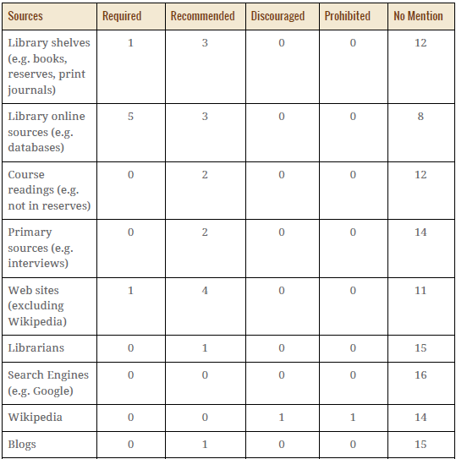
Guidance about the use of sources
Notes:
Little guidance about the use of sources
Most common – recommend library online sources, but no specifics, such as specific databases or journals
Students said that they sometimes feel overwhelmed when the come to the library website and have over 100 databases to chose from, they would like some suggestions about where to start.
None of the handouts mentioned the library research guides even though there were guides for the class.
Faculty interviews
Sometimes discuss use of sources in class. Others when asked this question mentioned, oh this would be a good idea.

Slide 13
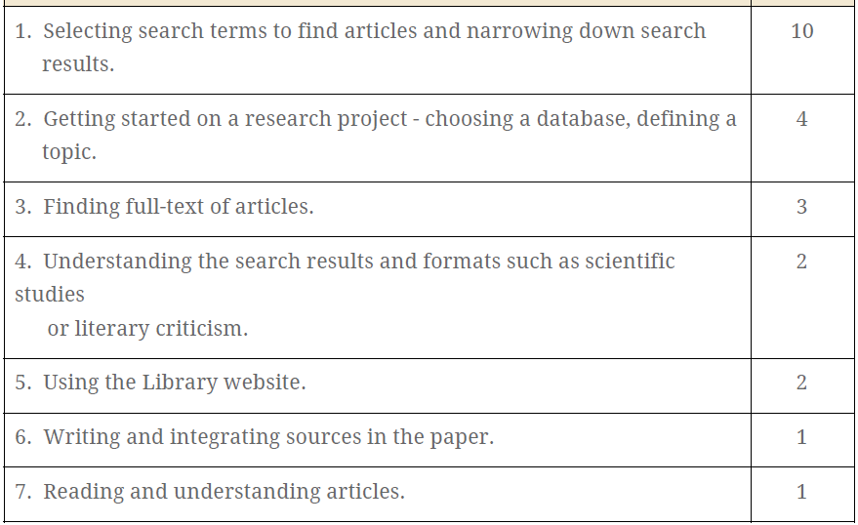
Most difficult research tasks
Notes:
From student interviews:
No guidance on searching and little help with getting started on a project.

Slide 14
Include specifics on research assignment handouts to help students get started.
“PIL – The Freshman Studies,” YouTube video, posted by “Project Information Literacy,” November 25, 2013,
https://www.youtube.com/watch?v=BWNGZUa952A&feature=youtu.be.
Notes:
Interviews with students:
Sometimes only verbal instructions for assignments.
My Handout
Add Library blurb to your syllabus or assignment handouts.

Slide 15
What type of support do students need to complete research assignments?

Slide 16
Types of Sources
Notes:
Websites – most frequently required type of source, little guidance on assignment handouts to help with evaluation of web sources.
Library instruction, often focus on articles from databases, need to talk about evaluating ALL types of sources.

Slide 17
Research Assignment Tasks
Notes:
Choosing a topic and citing sources
Many assignment handouts don’t even specific which citation style, let alone give guidance with citation

Slide 18
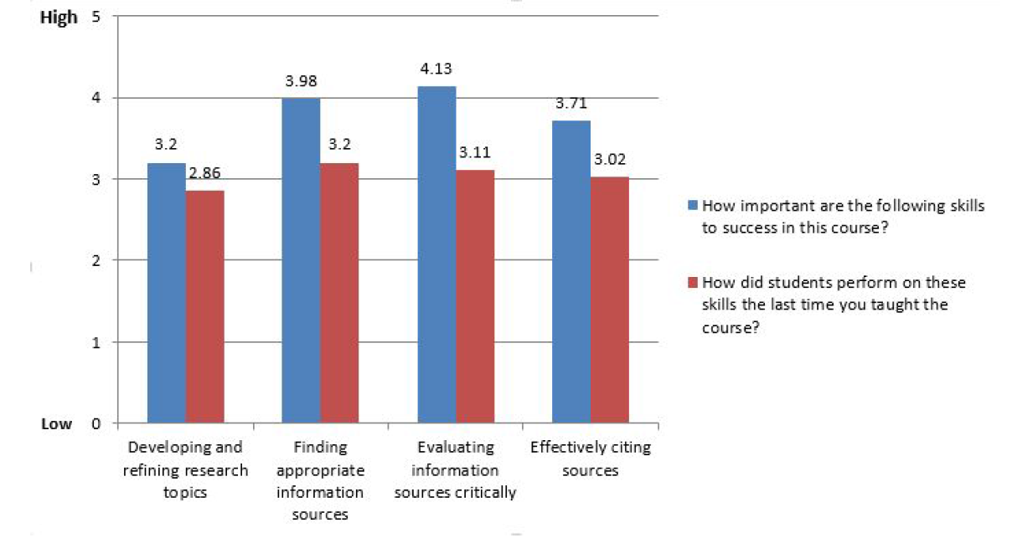
Importance of research skills to success in course and student performance on these skills

Slide 19
focus on source evaluation & lifelong learning
“Major Findings: PIL’s Lifelong Learning Study,” YouTube video posted by Project Information Literacy, January 4, 2016, https://www.youtube.com/watch?v=9DhNWg9c8fU
Notes:
Faculty interview
He explains that research skills are transferable and will serve them in jobs in the future, being able to come up with a question and find out about something they do not already know is an important life skill.

Slide 20
Improve awareness of library resources and services.
“Aware” by “nick fullerton” is licensed under CC BY 2.0.
Notes:
We have citation guides and offer citation assistance.
We have databases which can help students choose a topic.
We have research guides which teach students to evaluate sources.

Slide 21
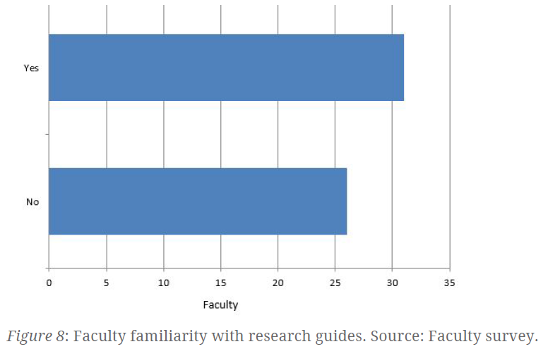
Services many Faculty were unaware of
Liaison Librarians
Research Guides
STARS Tutorial
Online Materials – DSM-IV Psychology Manual, Anatomy TV database
Librarians will work with faculty to develop assignments
Citation Handouts
Interlibrary Loan

Slide 22
Services many students were unaware of
Google Scholar
Study Rooms
Gaming Room
Tutoring Help in the Library
Research Guides
Specific Databases
Citation Help

Slide 23
Discussion Questions
What do your students find most challenging about completing research assignments?
What resources do you offer to support students in completing research assignments?
How could the Library better support students completing research assignments?
How can librarians and teaching faculty collaborate to support students?

Slide 24
How the Library Can Help
http://libguides.lcc.edu/assignments

Slide 25
Sign up for CTE workshop in November

Slide 26
Questions?
Suzanne Bernsten
Web Services Librarian
bernss@lcc.edu

